Slide 1
CS 2009 Design and Analysis of Algorithms
Waheed Ahmed
Email : waheedahmed@nu.edu.pk
Week 14.2:
NP-Completeness Reduction
Thomas H. Coreman (CLRS), Chapter 34.
JON KLEINBERG, EVA TARDOS, Chapter 8.

Slide 2
Reductions
Reduction is a way of saying that one problem is “easier” than another.
We say that problem A is easier than problem B, (i.e., we write “A ≤ B”)
if we can solve A using the algorithm that solves B.
Idea: transform the inputs of A to inputs of B
yes
α
f
β
Problem B
yes
no
no
Problem A

Slide 3
Polynomial Reductions
Given two problems A, B, we say that A is polynomially reducible to B (A ≤_{p} B) if:
There exists a function f that converts the input of A to inputs of B in polynomial time
A(i) = YES ⇔ B(f(i)) = YES

Slide 4
Polynomial Reduction
Polynomial time algorithm to decide A
yes
α
f
β
Polynomial time
algorithm to decide B
yes
no
no
Use a polynomial time reduction algorithm to
transform A into B
Run a known polynomial time algorithm for B
Use the answer for B as the answer for A

Slide 5
Implications of Reduction
Problem A reduces to problem B if you can use an algorithm that solves B to help solve A.
Cost of solving A = total cost of solving B + cost of reduction.
yes
α
f
β
Problem B
yes
no
no
- If A ≤_{p} B and B ∈ P, then A ∈ P
- if A ≤_{p} B and B ∉ P, then A ∉ P
Algorithm for Problem A

Slide 6
Reductions Examples
Problem A reduces to problem B if you can use an algorithm that solves B to help solve A.
Example 1. [finding the median reduces to sorting]
To find the median of N items:
Sort N items
Return item in the middle:
Cost of solving finding median = O(n log n) + 1
yes
α
f
β
Problem B
yes
no
no
Algorithm for Problem A
Cost of Sorting
Cost of Reduction

Slide 7
Reductions Examples
Problem A reduces to problem B if you can use an algorithm that solves B to help solve A.
Example 2. [element distinctness reduces to sorting]
To solve element distinctness on N items:
Sort N items
Check adjacent pairs for equality.
Cost of solving element distinctness = O(n log n) + O(n)
yes
α
f
β
Problem B
yes
no
no
Algorithm for Problem A
Cost of Sorting
Cost of Reduction

Slide 8
Reductions Examples
Convex hull. Given N points in the plane, identify the extreme points of the convex hull (in counterclockwise order).
Example 3. [Convex hull reduces to sorting.]
To solve convex hull:
Choose point p with smallest (or largest) y-coordinate.
Sort points by polar angle with p.
Consider points in order, and discard those that would create a clockwise turn.
Cost of solving element distinctness = O(n log n) + O(n)
yes
α
f
β
Problem B
yes
no
no
Algorithm for Problem A
Cost of Sorting
Cost of Reduction

Slide 9
RECIPE FOR PROVING PROBLEM Is NP-Complete
To Prove B Is NP-Complete
Prove that B is a member of the class NP. B ∈ NP
Choose an NP-complete problem A.
Prove that there is a Levin reduction from A to B.

Slide 10
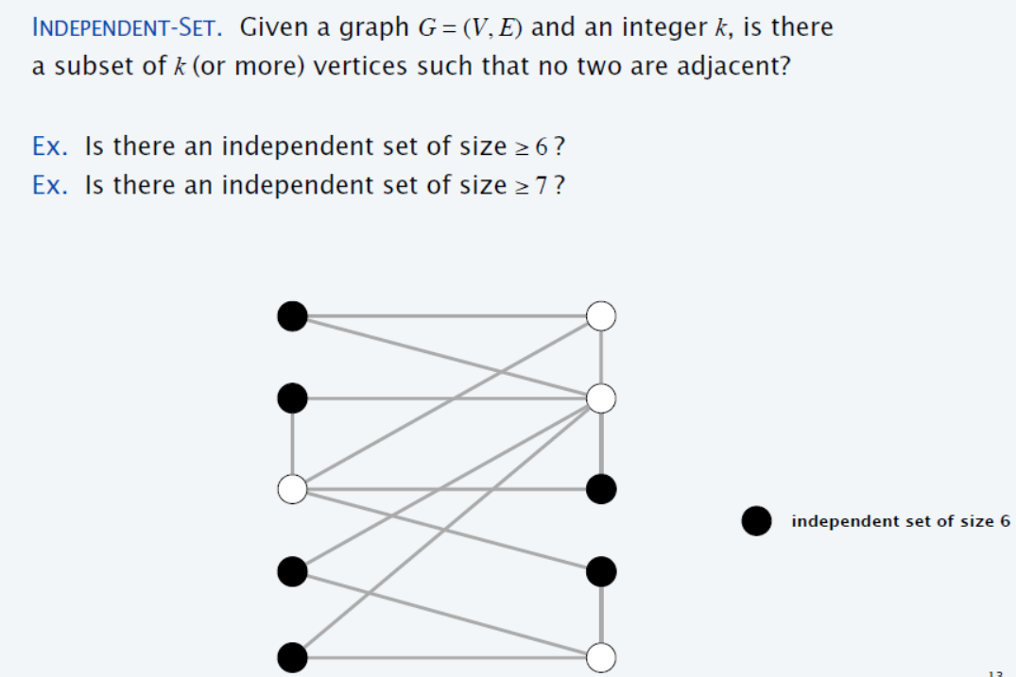
Independent Set (Example 1)
{1} is independent Set
{2, 3} is independent Set
{1, 3} is independent Set
{1, 3, 6} is independent Set
1
2
{2, 5, 6, 7} is independent Set
3
4
{1, 3, 6, 7} is independent Set
{1, 3, 6, 7, 8 , 9} is independent Set
5
6
7
8
9
10
Notes:
Independent-set set to Vertex Cover = V-Answer of Independent-set(S)

Slide 11
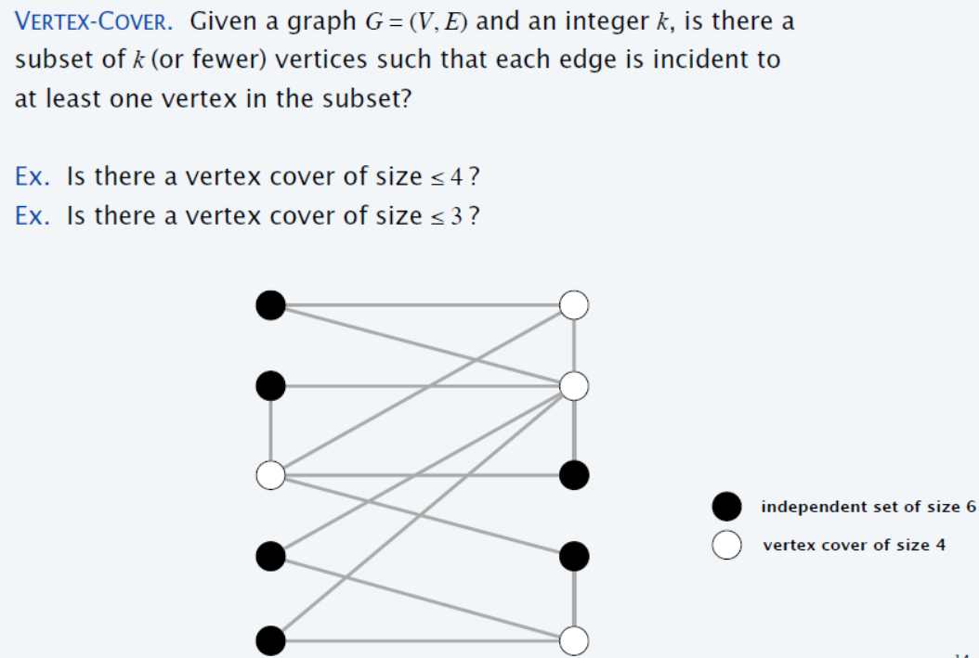
Vertex Cover (Example 1)
1
2
3
4
5
6
7
8
9
10

Slide 12
Vertex Cover is NP-Complete
Recipe to Prove a Problem Is NP-Complete
Prove that a Vertex Cover is NP-Complete
Step 1. Vertex Cover ∈ NP
Step 2. Choose an NP-Complete problem A (Independent Set).
Prove that A (Independent set) reduces to B (Vertex Cover)
INDEPENDENT-SET ≤_{p} VERTEX-COVER.
Notes:
We already have solution of Independent Set (Problem A), and we want to use the same solution of Problem A for Problem B (Vertex Cover), and this mapping of solution A to solution B (solution B needs to find out), must be in polynomial time)

Slide 13
Step 1: Vertex Cover ∈ NP
Given Graph G = (V, E) contains Vertex cover of Size 3?
S is vertex cover if every edge in E has at least one endpoint in S.
(Example V.C = {2,3,7})
1
2
3
4
5
6
7
Notes:
We can verify in P-time

Slide 14
Vertex cover and independent set reduce to one another
Lemma: INDEPENDENT-SET ≤_{p} VERTEX-COVER.
Proof: We show S is an independent set of size k,
iff V − S is a vertex cover of size n – k.
Let S be any independent set of size k.
Consider an arbitrary edge (u, v) ∈ E.
S independent ⇒ either u ∉ S, or v ∉ S, or both ∉ S.
Vertex Cover (V-S)⇒ either u ∈ V − S, or v ∈ V − S, or both ∈ V − S.
Thus, V − S covers (u, v). ▪
2
S = {4,5}
4
5
7

Slide 15
Independent Set (Example 2)
S is independent if there are no edges between vertices in S.
(Example I.S = {1,4,5,6})
V.C = V – S
(V.C ={2,3,7})
1
2
1
2
VC = V - S
3
4
5
3
4
5
6
7
6
7
Notes:
Indepenset set to Vertex Cover = V-Answer of indepense set(V)
Compliment graph of indepenset set in cliqie

Slide 16
Clique (Example 2)
Clique
Graph G = (V, E), a subset S of the vertices is a clique if there is an edge between every pair of vertices in S. (Example Clique = {1,4,5,6})
2
1
Clique of size 4
3
4
5
6
7

Slide 17
Clique is NP-Complete
Recipe to Prove a Problem Is NP-Complete
Prove that a Clique is NP-Complete
Step 1. Clique ∈ NP.
Step 2. Choose known NP-Complete problem A (IS).
Prove that A (IS) reduces to B (Clique)
IS ≤_{p} Clique.

Slide 18
Step 1: Clique ∈ NP.
Graph G = (V, E), a subset S of the vertices is a clique if there is an edge between every pair of vertices in S. (Example Clique = {1,4,5,6})
Given graph contains Clique of size = 4 ?
2
1
3
4
5
6
7
Notes:
Every vertex of S contained each other. (Mesh Connected)

Slide 19
Step 2: IS ≤_{p} Clique
Lemma: S is Independent in G iff S is a Clique in the complement of G
To reduce IS to Clique, we compute the complement of the graph. The complement has a clique of size K iff the original graph has an independent set of size K.
Construction of Complement of the graph can easily be done in polynomial time.

Slide 20
IS ≤_{p} Clique (Example 2)
2
1
2
Complement
1
3
4
5
3
4
5
6
7
6
7
Independent-Set of Size 4
Clique of Size 4

Slide 21
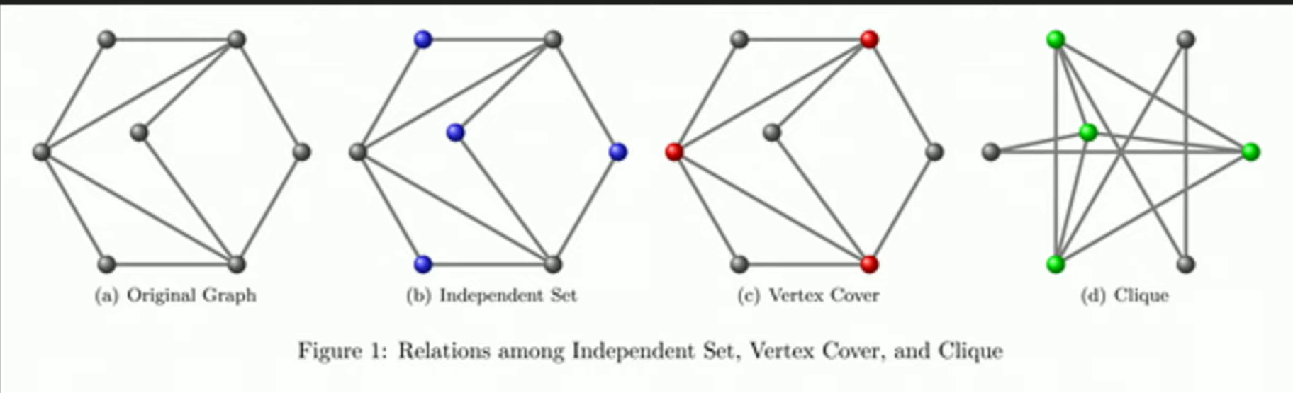
Reduction: Independent Set, Vertex Cover, and Clique (Example 3)

Slide 22
INDEPENDENT-SET is NP-Complete
Recipe to Prove a Problem Is NP-Complete
To prove that a problem B (INDEPENDENT-SET) is NP-Complete:
Step 1. INDEPENDENT-SET ∈ NP
Step 2. Choose an NP-Complete problem A (3-SAT).
Prove that A (3-SAT) reduces to B (INDEPENDENT-SET)
3-SAT ≤_{p} INDEPENDENT-SET

Slide 23
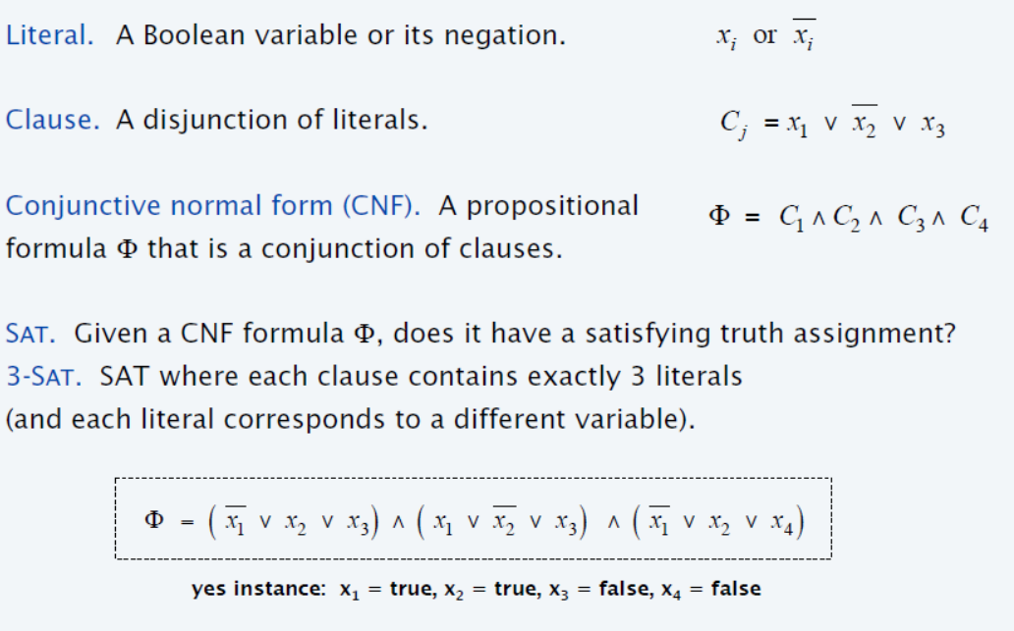
Satisfiability

Slide 24
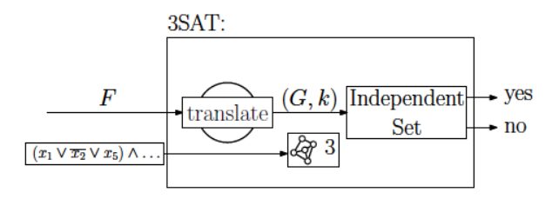
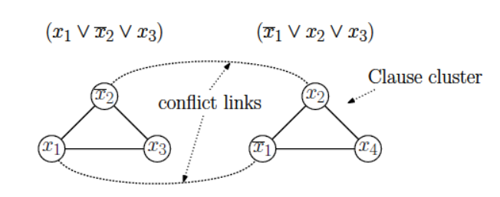
3-satisfiability reduces to independent set

Slide 25
3-satisfiability reduces to independent set

Slide 26
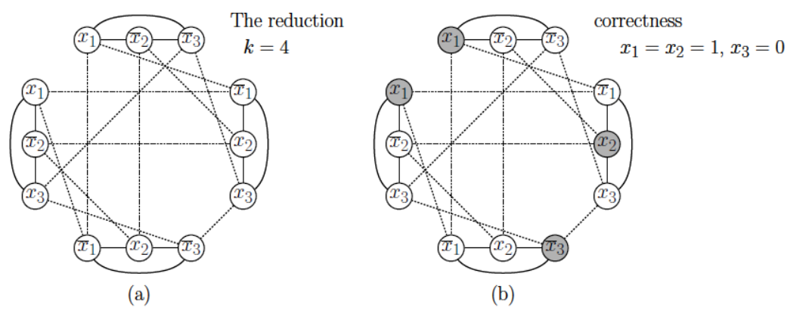
3-satisfiability reduces to independent set

Slide 27
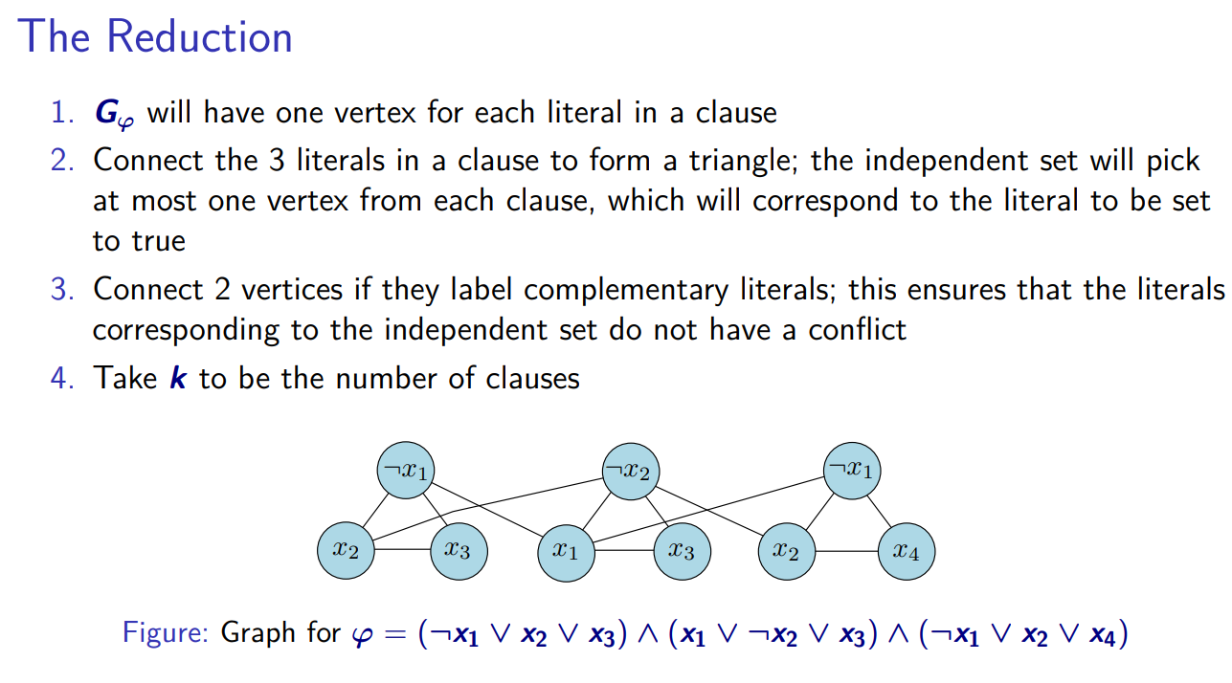

Slide 28
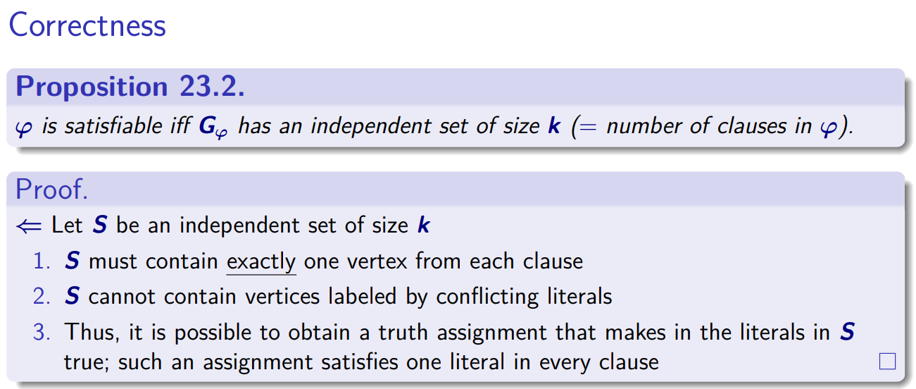

Slide 29
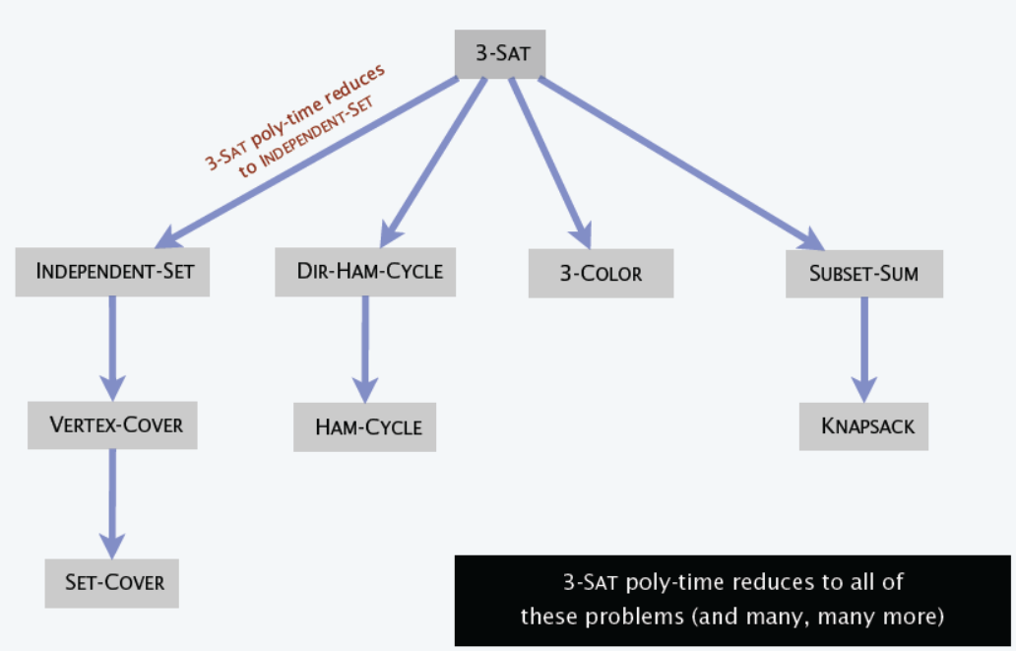
Poly-time reductions

Slide 30
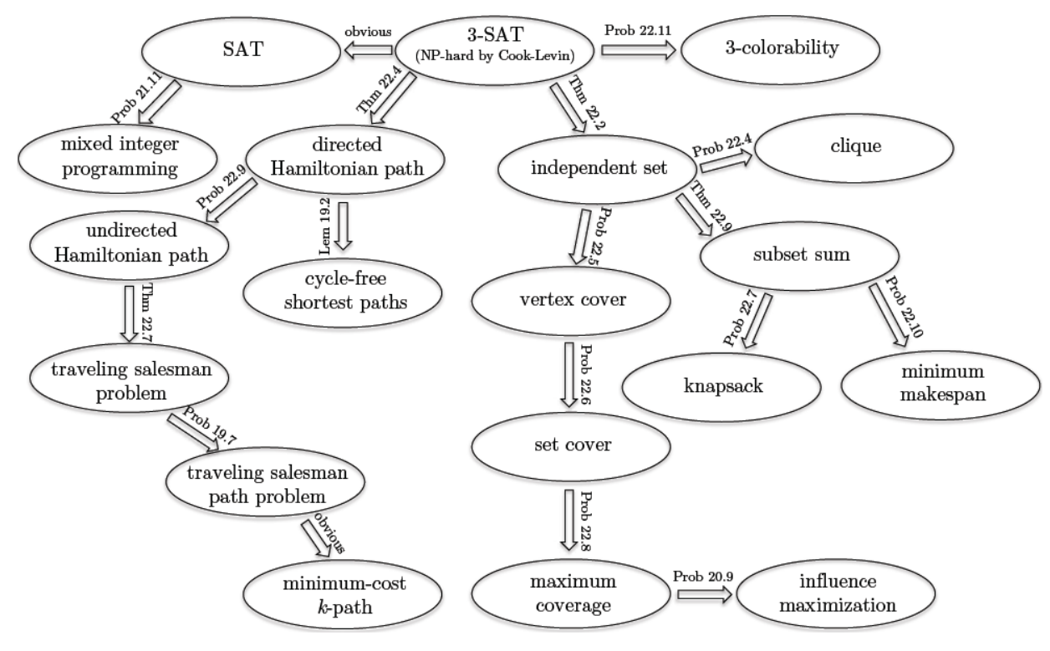
Cook-Levin theorem shows that 3-SAT is a “universal” problem

